Slide 1
DDR Controller Coding
Diandian Chen

Slide 2
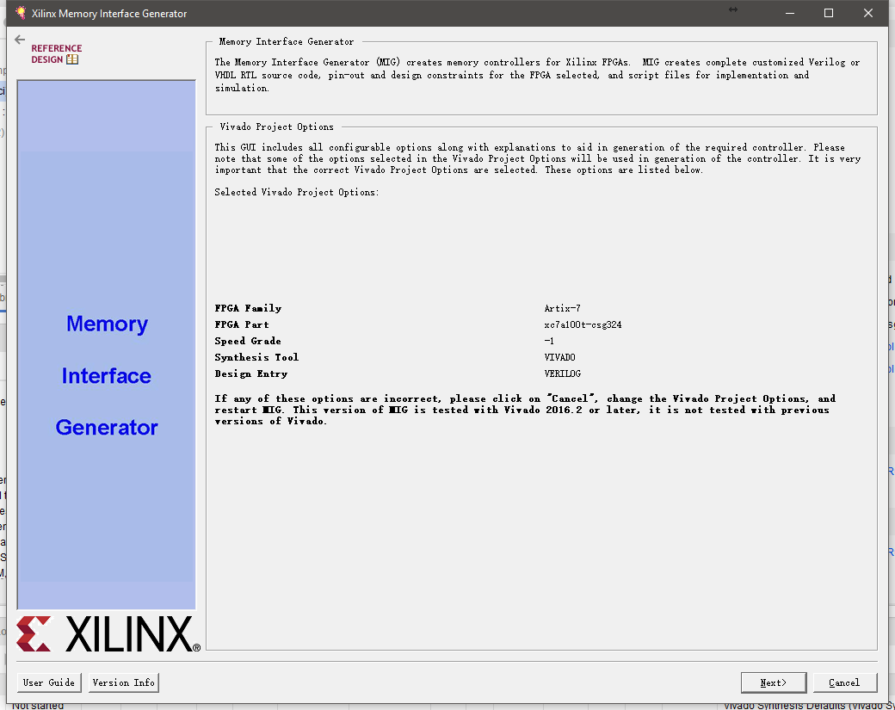
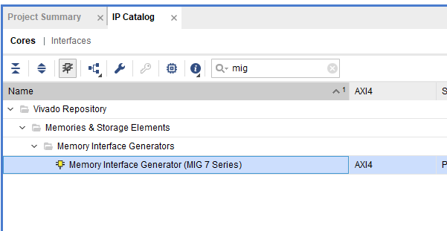
Generate DDR IP with Memory Interface Generator
Here the configuration is based on the recommended settings used by majority (this configuration is provided in Digilent controller IP site, and as far as I’ve seen, most people discussing about this DDR are using this configuration in the forums, personal blogs etc.). We cannot say this is the best configuration for our project, because we need the overall implementation to work to test the maximum bandwidth, so for most settings we are just following the recommendation.

Slide 3
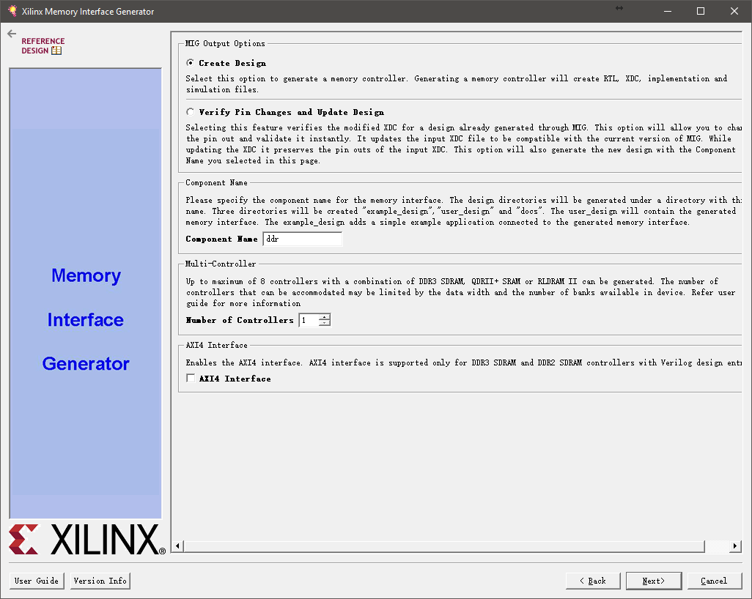
Generate DDR IP with Memory Interface Generator
We don’t need AXI4 in our project

Slide 4
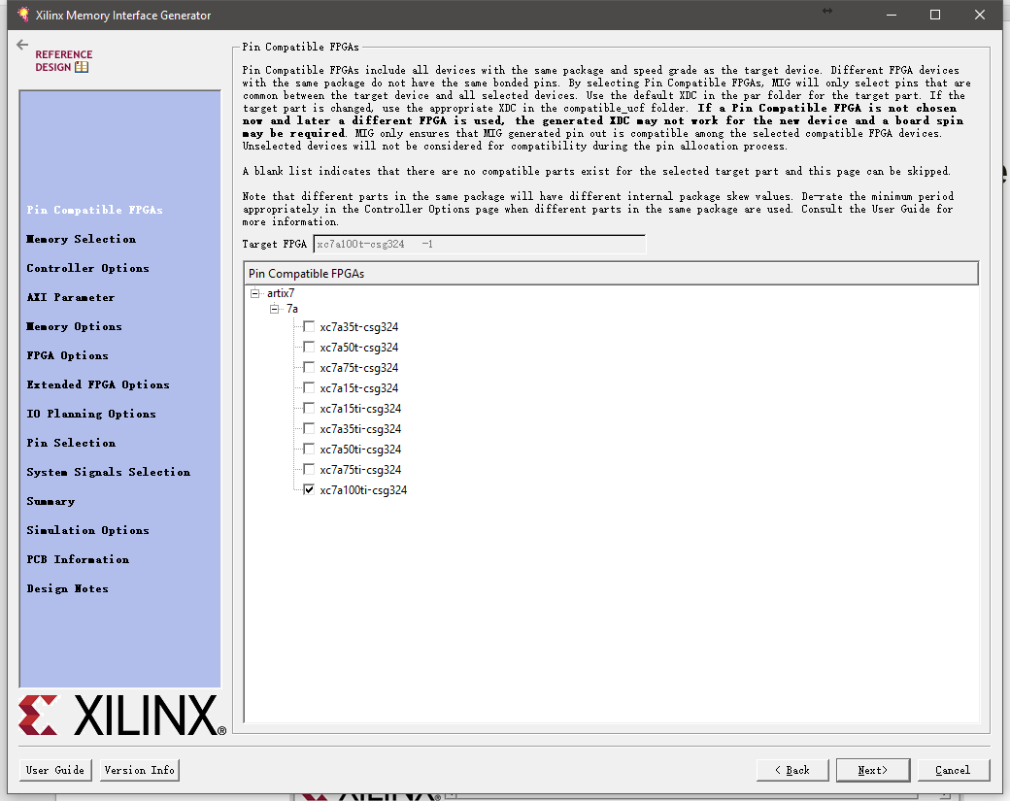
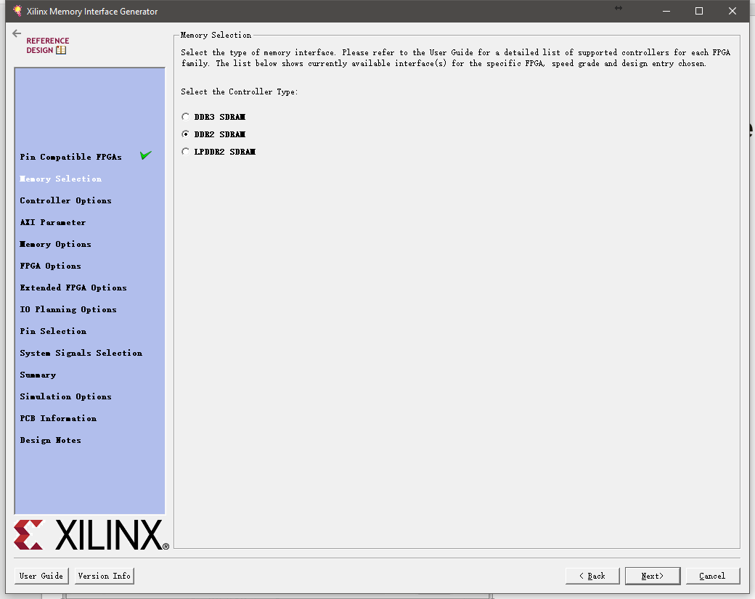
Generate DDR IP with Memory Interface Generator
Choose the right board number and available DDR generation

Slide 5
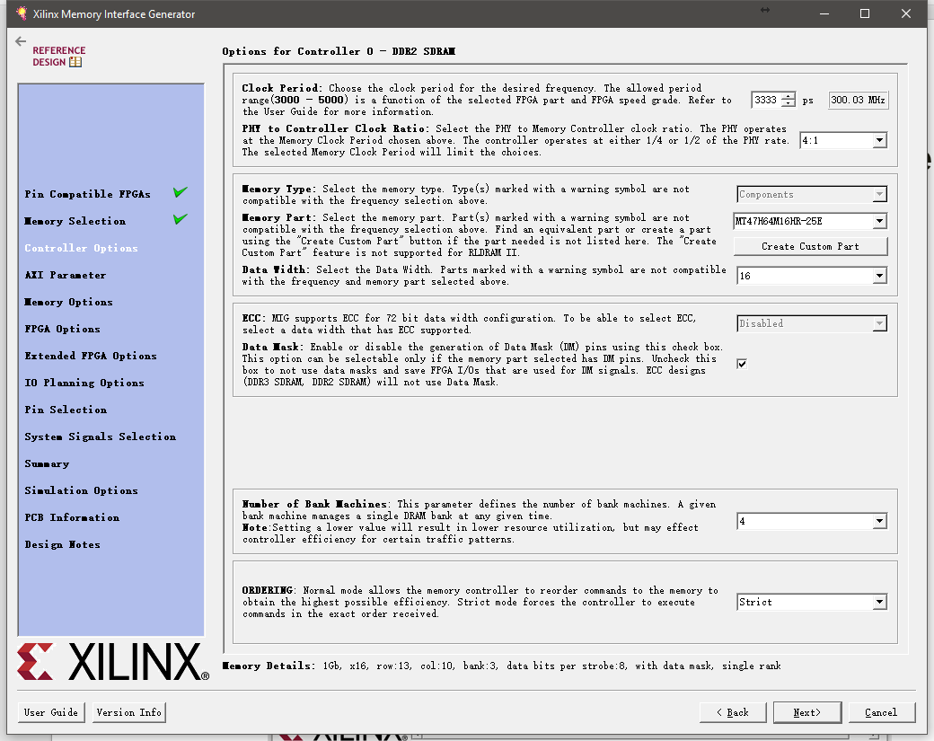
Generate DDR IP with Memory Interface Generator
The clock period 3333 ps is said to be a recommended value by the user guide, 3250 is good as well
PHY to Controller Clock Ratio determines the ui_clk. With such setting our ui_clk is 75 MHz.

Slide 6
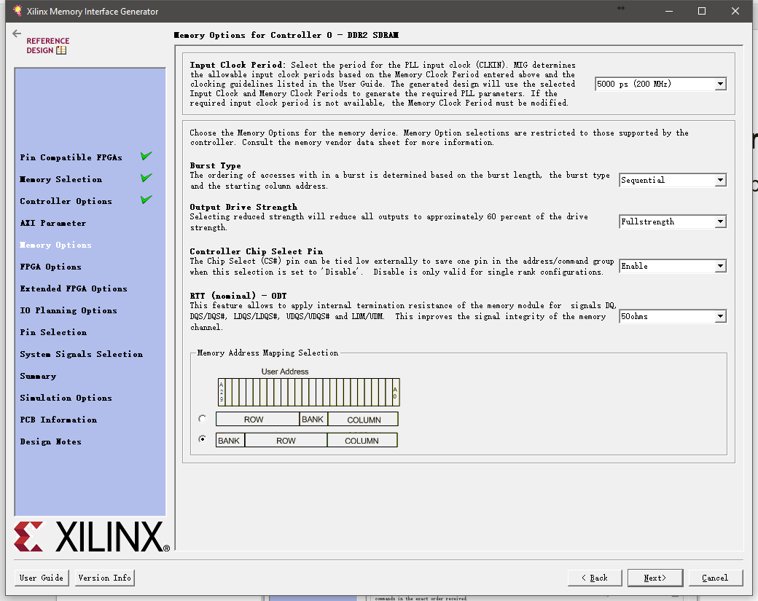
Generate DDR IP with Memory Interface Generator
Options for Input Clock Period can be different with different settings at previous page

Slide 7
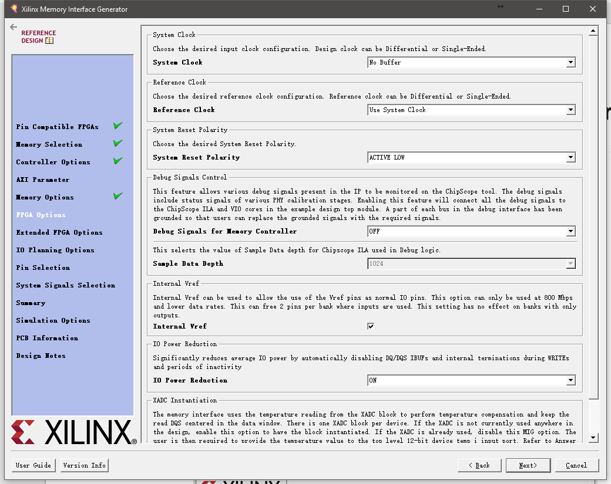
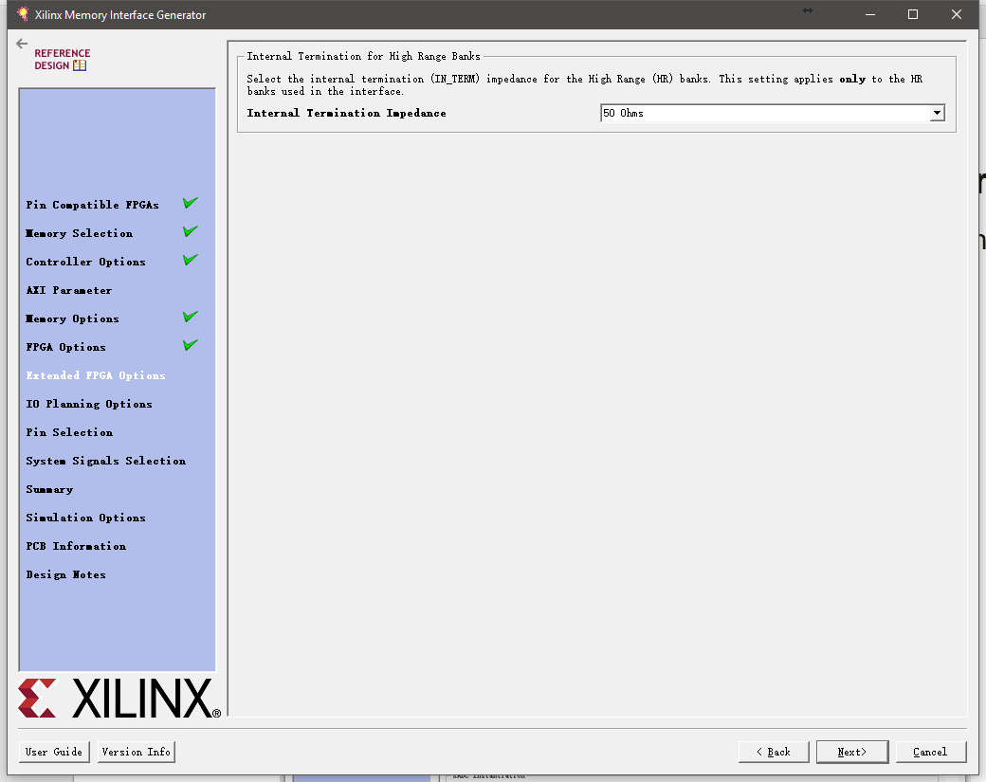
Generate DDR IP with Memory Interface Generator
These are system control configuration for the interface, nothing much to concern

Slide 8
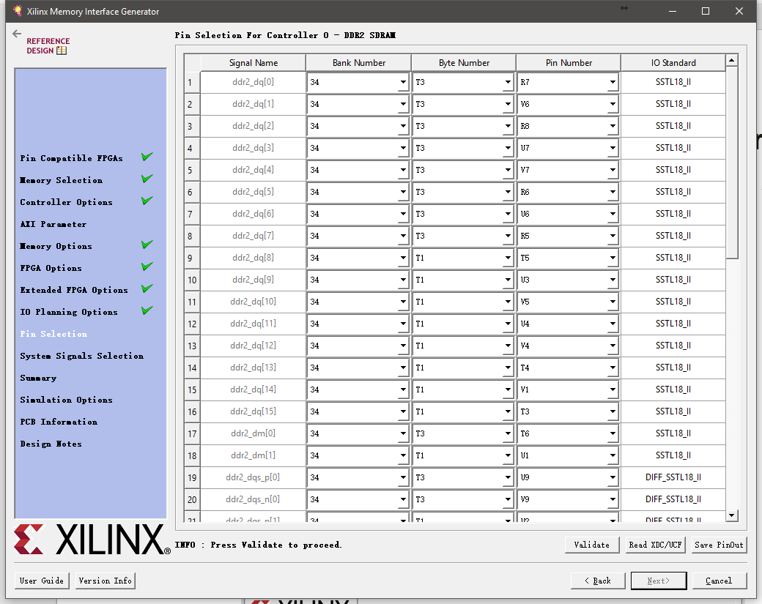
Generate DDR IP with Memory Interface Generator
Here we need to load the given physical constraint file to complete the pin connection for the DDR. All the ports shown here should be finally claimed as output/inout pins of the top module. (Read XDC/UCF -> load Nexys4DDRmemorypinout.ucf provided -> Validate -> Next)

Slide 9
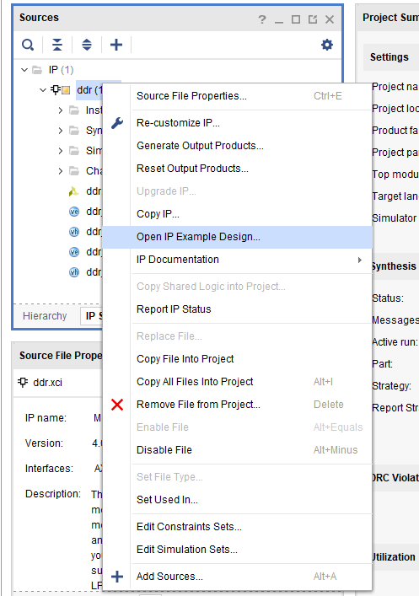
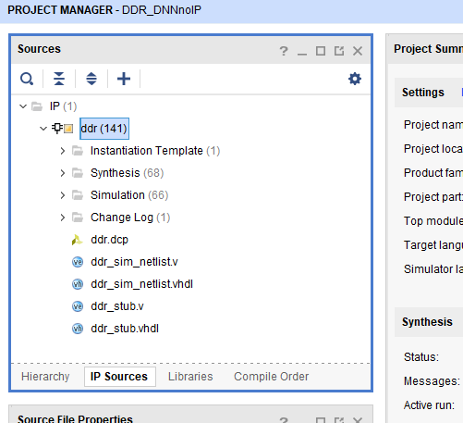
Generate DDR IP with Memory Interface Generator
After the DDR MIG IP Core has been generated, you can find this Core under IP Sources
Right click this IP and you can choose Open IP Example Design and check what’s going on in the new example design to see how signals are put and given during DDR traffic

Slide 10
DDR Controller Coding Guide
Different commands offered to and data read out from DDR are aligned to the output clk signal from DDR “ui_clk”, whose frequency can be configured by given options when customizing the IP. In our design, this clk is 75MHz.
For valid read and write commands, enable signal “app_en” should be asserted, and the command type signal “app_cmd” should be put accordingly (e.g. “0” for write and “1” for read).

Slide 11
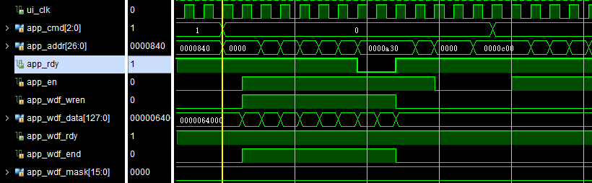
DDR Controller Coding Guide
During a write command, write address and write data are offered separately (but “app_en” should always be asserted)
First the “cmd” signal should be “0” indicating this is a “write”. You can offer an “app_wdf_end” signal indicating the end of currently written data, in our design and official example design it’s always “1” during an activated write command
For address, consecutive addresses can be put on input lines as long as “app_rdy” is 1, otherwise the address line should be held until it becomes 1

Slide 12
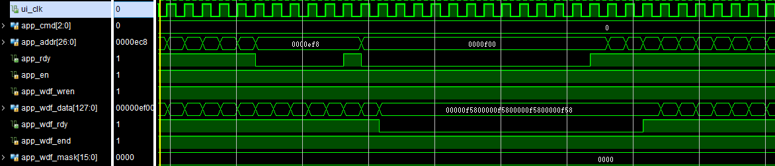
DDR Controller Coding Guide
For data, consecutive data can be put on input lines as long as “app_wdf_rdy” is 1, otherwise the data line should be held until it becomes 1. Here write data are fed into a FIFO inside DDR IP, and write enable signal for this FIFO “app_wdf_wren” should be kept high when writing valid data. Here data are 128-bit.

Slide 13
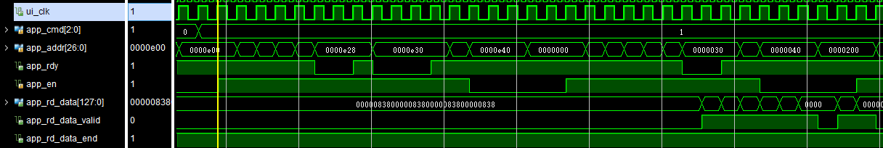
DDR Controller Coding Guide
For read, consecutive addresses can be put on input lines as long as “app_rdy” is 1, otherwise the address line should be held until it becomes 1. Here read data are 128-bit
The latency between an enabled read command and the first data read out is normally 25 ui_clk, and there is also an “app_rd_data_valid” signal indicating the validity of currently read data.

Slide 14
DDR Controller Coding Guide Summary
signals | WRITE | READ
app_en | keep high until sending address & data are both finished | keep high until sending address is finished
app_cmd | 0 | 1
app_addr | address is successfully sent if (app_en && app_rdy) == 1 for current cycle | address is successfully sent if (app_en && app_rdy) == 1 for current cycle
app_wdf_data | data is successfully sent if (app_en && app_wdf_rdy && app_wdf_wren) == 1 for current cycle | -
app_wdf_wren | should be kept 1 when sending data to write | 0
app_wdf_end | always 1 | -

Slide 15
Some Stats
Based on the configuration given, internal clock frequency of DDR is 300 MHz, and PHY to Controller Clock Ratio is 4:1, which means DDR interface will offer a 300 MHz / 4 = 75 MHz clock for controller design, and our controller is working under this 75 MHz clock to send commands and receive data
Data Width is 16b, so every 75 MHz clock we can expect 16b * 4 (Ratio) * 2 (DDR) = 128b data read from DDR

Slide 16
Some Stats
Based on what we see from the simulation waveforms, consecutive addresses for read can be kept feeding into DDR as long as “app_rdy” is high, and during this about 4/5 of all time “app_rdy” is always high
Once read commands are fed into DDR, we can fetch read data as long as “app_rd_data_valid” is high, and this signal can be high in about 7/8 of all time
Due to the limit of that we can only observe how signals are given based on certain test cases of the example design, we don’t know what will happen if we just keep reading DDR with maximum bandwidth during all time. The estimated full bandwidth based on example design is about 738 MB/s, which is too high for the recommended (by Digilent) maximum bandwidth 650 Mbps

Slide 17
Testbench for DDR Controller
A testbench project integrating DDR simulation model (ddr2_model.v) and DDR controller (ddr_ctrl.v) has been uploaded to Github. (DDR model extracted from MIG example design)
Include everything in the folder into a project
Generate MIG IP following the first several slides (make sure “component name” of it is “ddr” as shown).
Generate a FIFO IP following the next several slides (make sure “component name” of it is “fifo_128” as shown).
Start behavioral simulation (and manually “Run all”).
At about 108 us you should be able to observe initialization of DDR done (signal “init_calib_complete” rises).
Between 108 us and roughly 116 us, controller keeps sending write commands to DDR (simple incremental address/data write) (check I/Os of controller)
At roughly 116.45 us and since then, you should observe valid data read from DDR flowing into FIFO (check I/Os of controller and FIFO)

Slide 18
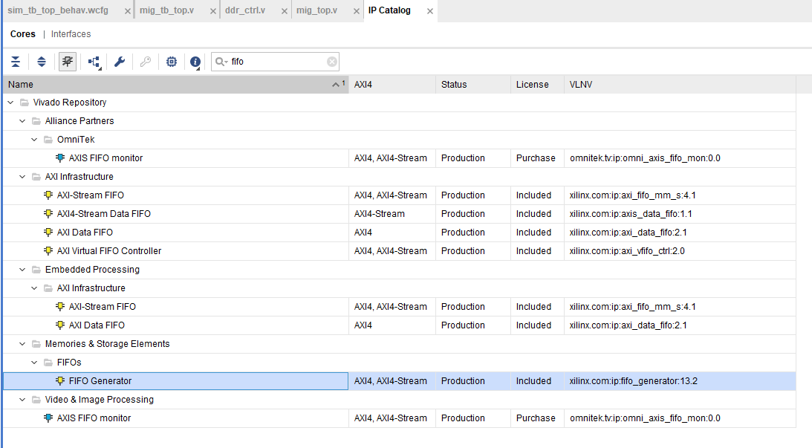
Generate FIFO IP for the Project

Slide 19
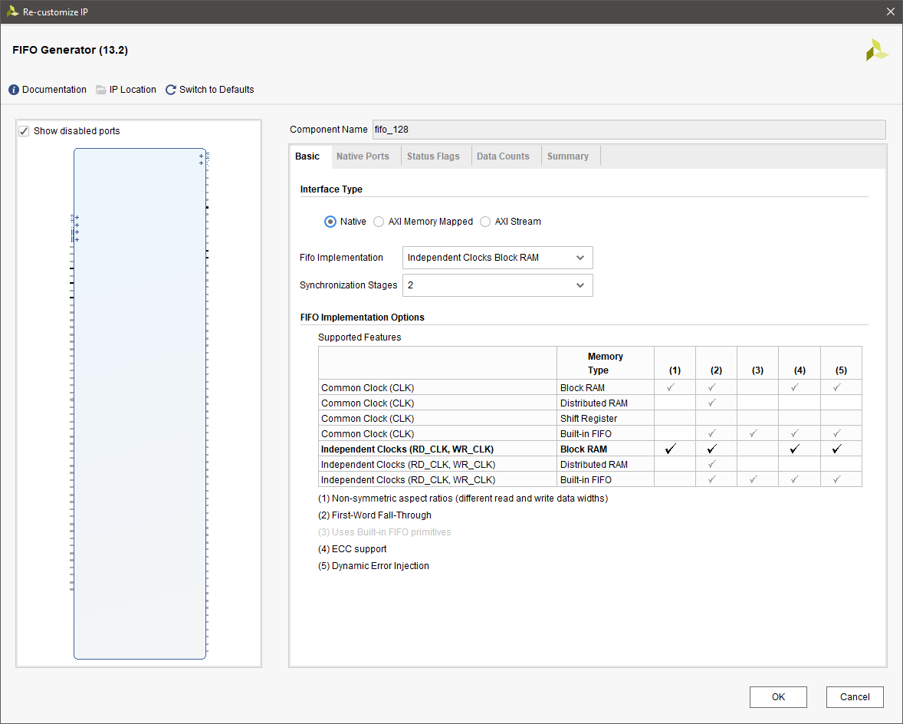
Generate FIFO IP for the Project

Slide 20
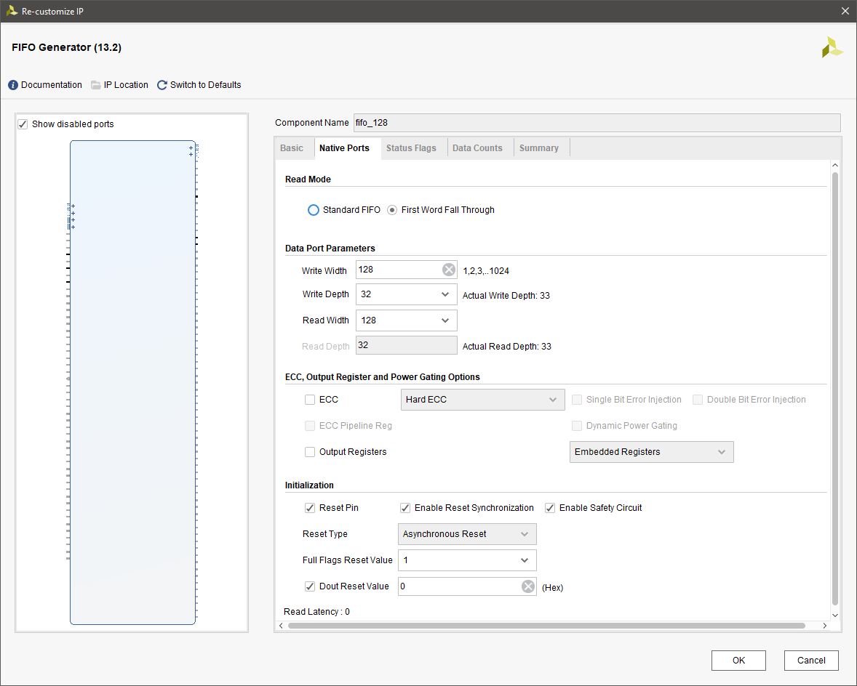
Generate FIFO IP for the Project

Slide 21
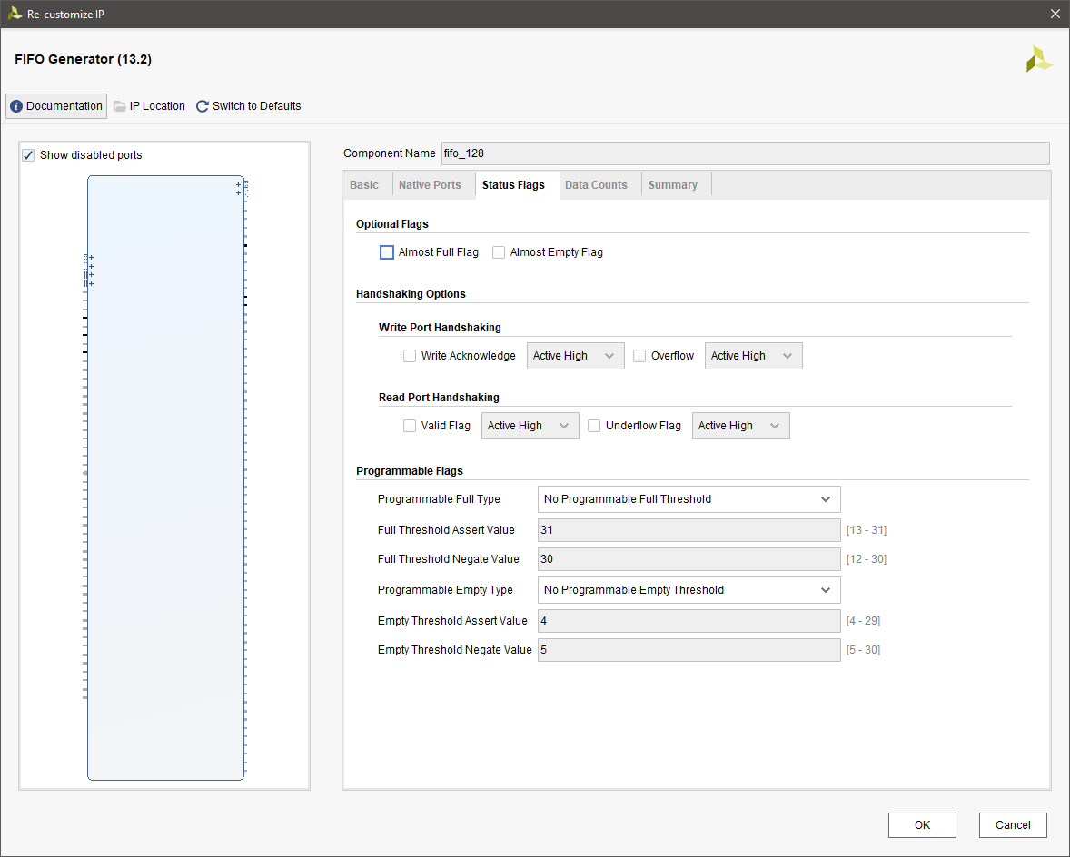
Generate FIFO IP for the Project

Slide 22
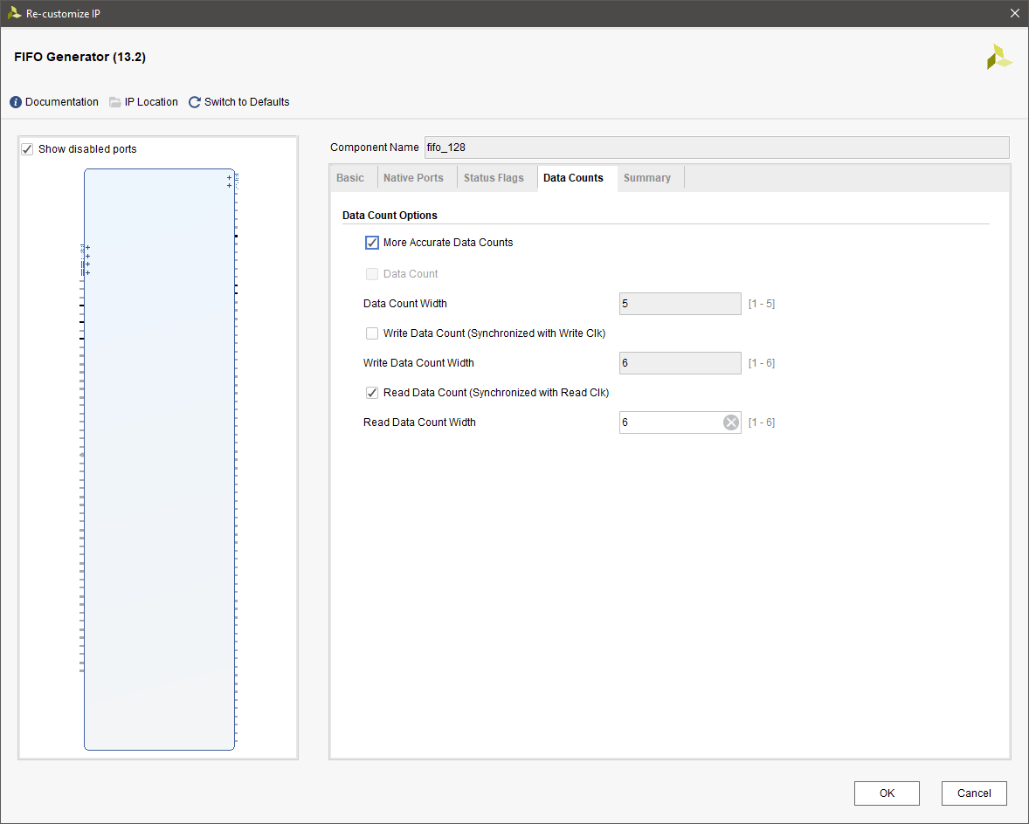
Generate FIFO IP for the Project

